Slide 1

Developing a Predictive Churn Analysis Web App for Telco Customers
Capstone Project

Slide 2
General Information
Summary
Problem: Telco companies face challenges in retaining customers, and predicting customer churn is crucial for proactive management. However, the manual identification of potential churners is time-consuming and inefficient.
Solution: Developing a web app that leverages machine learning models to analyze historical customer data allows Telco companies to predict churn, enabling timely intervention and personalized retention strategies.
Problem Statement
Inefficient manual identification of potential customer churn poses a challenge for Telco companies, hindering proactive retention strategies. There is a need for an automated solution that leverages machine learning models to analyze historical customer data and predict churn, enabling timely interventions and personalized retention efforts.
Deliverables
GitHub

Slide 3
Project Overview: Predictive Churn Analysis Web App for Telco Customers
Techniques and Models: The project utilizes machine learning techniques for predictive churn analysis. Several classification models, including k Nearest Neighbor, Support Vector Machines, Random Forest, and Gradient Boosting, were experimented with. Hyperparameter tuning was performed to enhance model performance.
Data Source: The data on Telco customer behavior, including usage patterns, contract details, and customer support interactions, was collected from Kaggle databases. The dataset was carefully curated to include labeled information indicating whether a customer churned or not.
Data Analysis: Data preprocessing involved handling encoding categorical variables. Exploratory data analysis was conducted to identify patterns and correlations between features.
Model Creation: The selected machine learning models were trained simply. Rigorous model evaluation was performed using metrics such as accuracy and especially F1 score, which is important to that case since it was an unbalanced dataset. A model with higher accuracy was fine-tuned through hyperparameter optimization to achieve optimal performance.
Web App Development: The web app was developed using Streamlit. The interface allows users to input relevant information for churn prediction. The deployed model processes these inputs and provides predictions.
Monitoring and Maintenance: To ensure continued accuracy, the model should regularly be updated with new data. However, this was not performed here.
Ethical Considerations: Throughout the project, ethical considerations, data privacy regulations, and fairness in model predictions were prioritized to ensure responsible and unbiased usage of predictive analytics in the Telco industry.

Slide 4
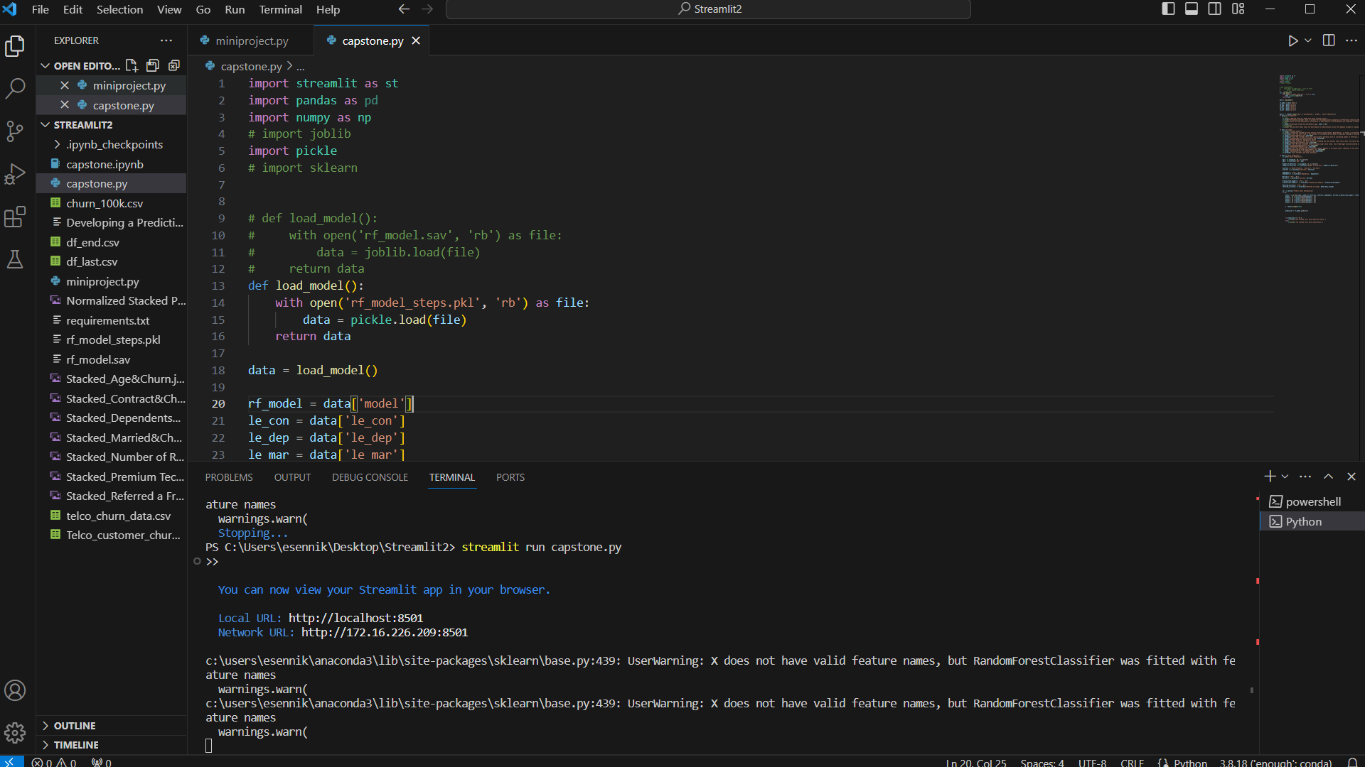
Running the capstone.py by using VS Code

Slide 5
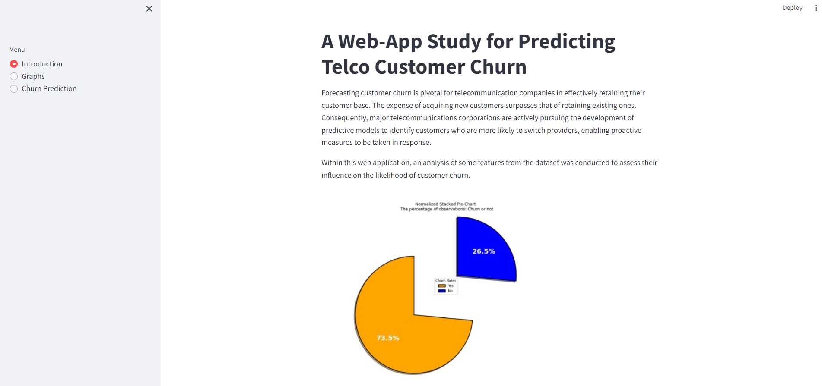
General overview of the web app (1)
The interactive sidebar allows you to see the related graphs and prediction page

Slide 6
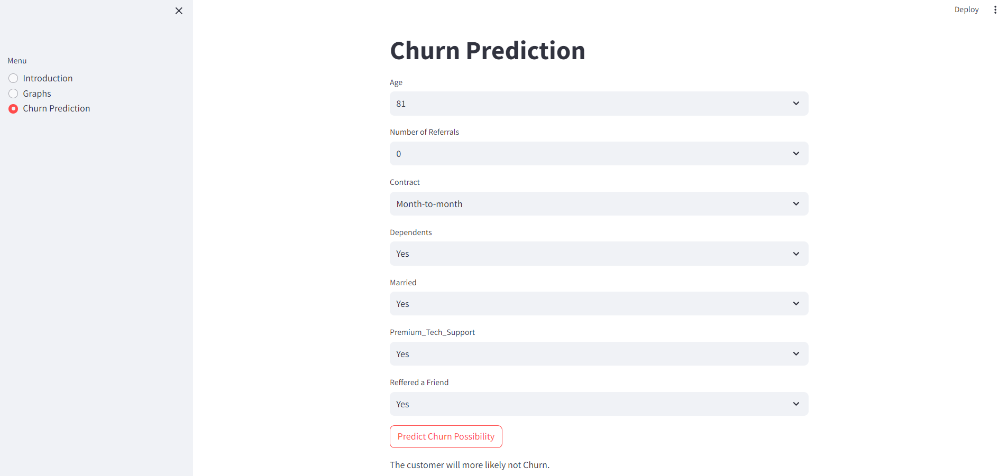
General overview of the web app (2)
An example for prediction page
If a customer is older and has only a month-to-month contract, the prediction result shows the customer is more likely to churn. In this case, the business department can find a solution to play with the other features.

